Slide 1
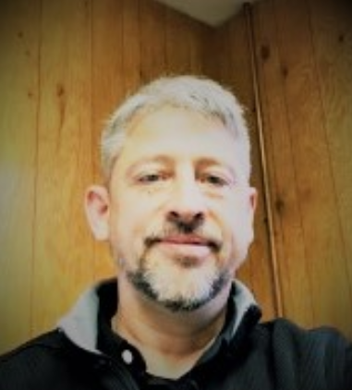
Black and White Poster 01
MARK JEFFERS EXECUTIVE DIRECTOR mark@aitkingrowth.org 320-360-0918 MakeItInMN.com
Profile I have been a Minnesota Lakes area resident for 30+ years. Married to my wife Lara. Together, we have 3 children, Cody, Makenzie and Madison. I have an energy for community events and involvement. I believe that in order to serve the community and help support and grow the community, you have to be engaged in the community. That has been and will continue to be my focus.
Background I am originally from the East Coast (the right coast). Easton PA. I graduated HS from Easton Area High School (Go Red Rovers!) and attended Slippery Rock University in Pennsylvania. After arriving in Minnesota in 1991, I joined the Viking Coca-Cola Family and had spent 28 years in various areas of business from sales, management, corporate management and Director, specializing in servicing and growing profitability for small business throughout Viking territories in MN and WI.
Skills Business Plan creation and profitability training Event logistics Project Management
Interests Lake life All types of entertainment and musical events Social gatherings with close friends NFL
Community I am currently a member of the Aitkin Chamber Board of Directors, serving on the Economic Development, Retail and Partnership committees. I am also currently serving on the City of Aitkin Planning Commission. I have served on the Board of Directors and am a current member of the Garrison Commercial Club.

